Slide 1
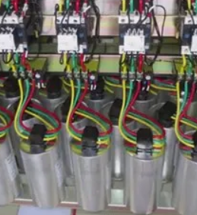
POWER FACTOR CORRECTION
NAME | REG NO
ABDURRAHIM | 368948
MUHAMMAD ISMAEEL BUTT | 387739
SYED MUHAMMAD MUSLIM | 381012
SALMAN ALI | 368948

Slide 2
INTRODUCTION
In our country, energy crisis is one of the major concerns. Effective power transmission and power utilization of this power is one of the main issues.
The Power Factor is the invisible factor, which causes a great loss of electrical energy and also damages electrical equipment.
The Power Factor of varying load can be measured and compensated using static method.

Slide 3
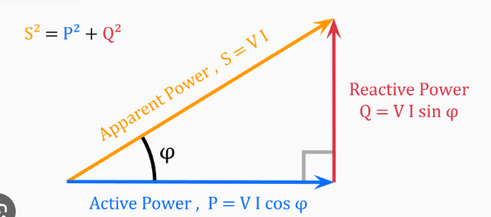
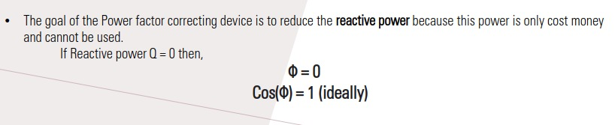
MATHeMATICAL MODEL

Slide 4
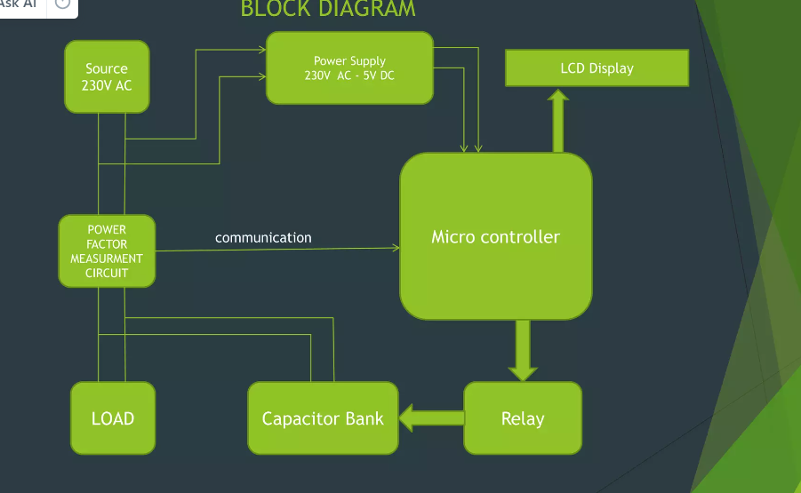
BLOCK DIaGRAM

Slide 5
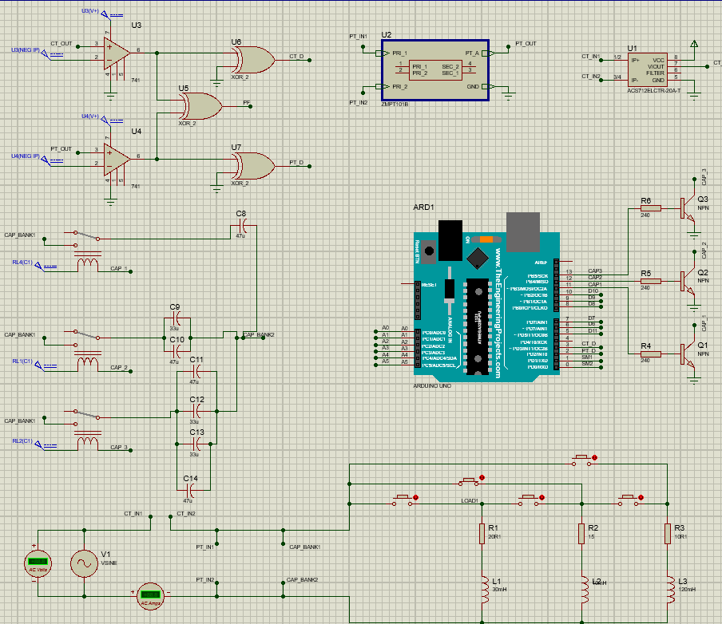
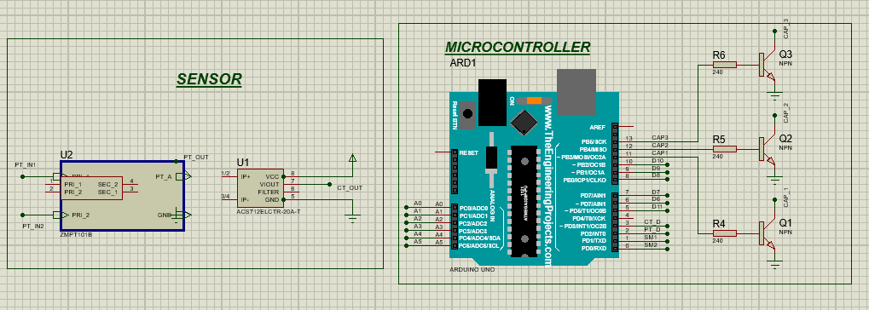
CIrCUIT DIaGRaM

Slide 6
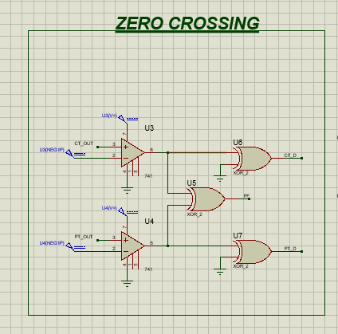
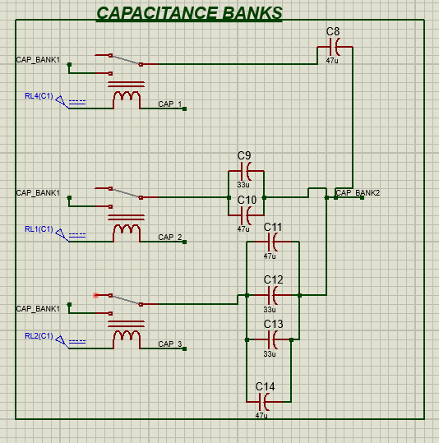
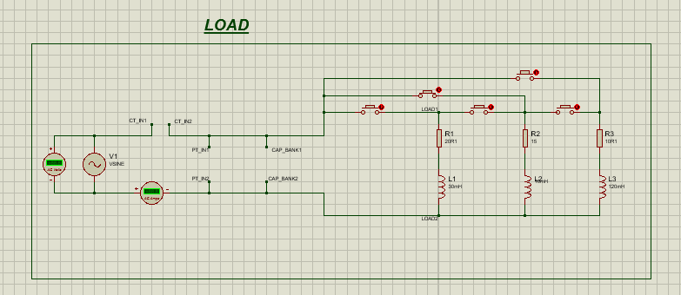
SIMULATION MODULES:

Slide 7
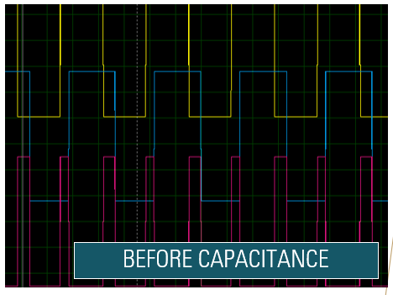
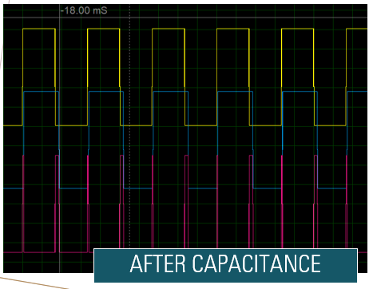
RESULTS

Slide 8
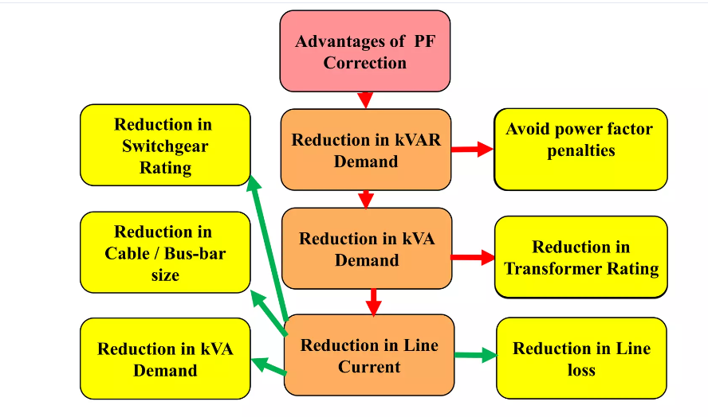

Slide 9
Research areas
Power factor control using AI techniques
Smart PFC Device for solar grids
Real-Time Monitoring and Control Software: Creating software platforms for real-time monitoring and control of PFC systems, ensuring they operate optimally and can quickly respond to changes in load conditions

Slide 10
CONCLUSION
This technique used to overcome power losses due to low power factor associated with common household and small industrial units.
By installing suitably sized capacitors into the circuit the Power Factor is improved and the value becomes nearer to unity thus minimising line losses and improving the efficiency of a plant.

Slide 11
REFERNCE
[1]Three-phase-synchronous-generator
[2] Arduino Based Automatic Power Factor Control, publication by Md Abdullah Al Rakib, Sumaiya Nazmi, Md Hasan Imam and Mohammad Nasir Uddin
[3] AUTOMATIC POWER FACTOR CONTROL USING ARDUINO UNO Ravi Dhameliya , Kaushik Domadiya , Pratik Miyani, Hiren Savaliya, Pratik Jariwala

